Slide 1
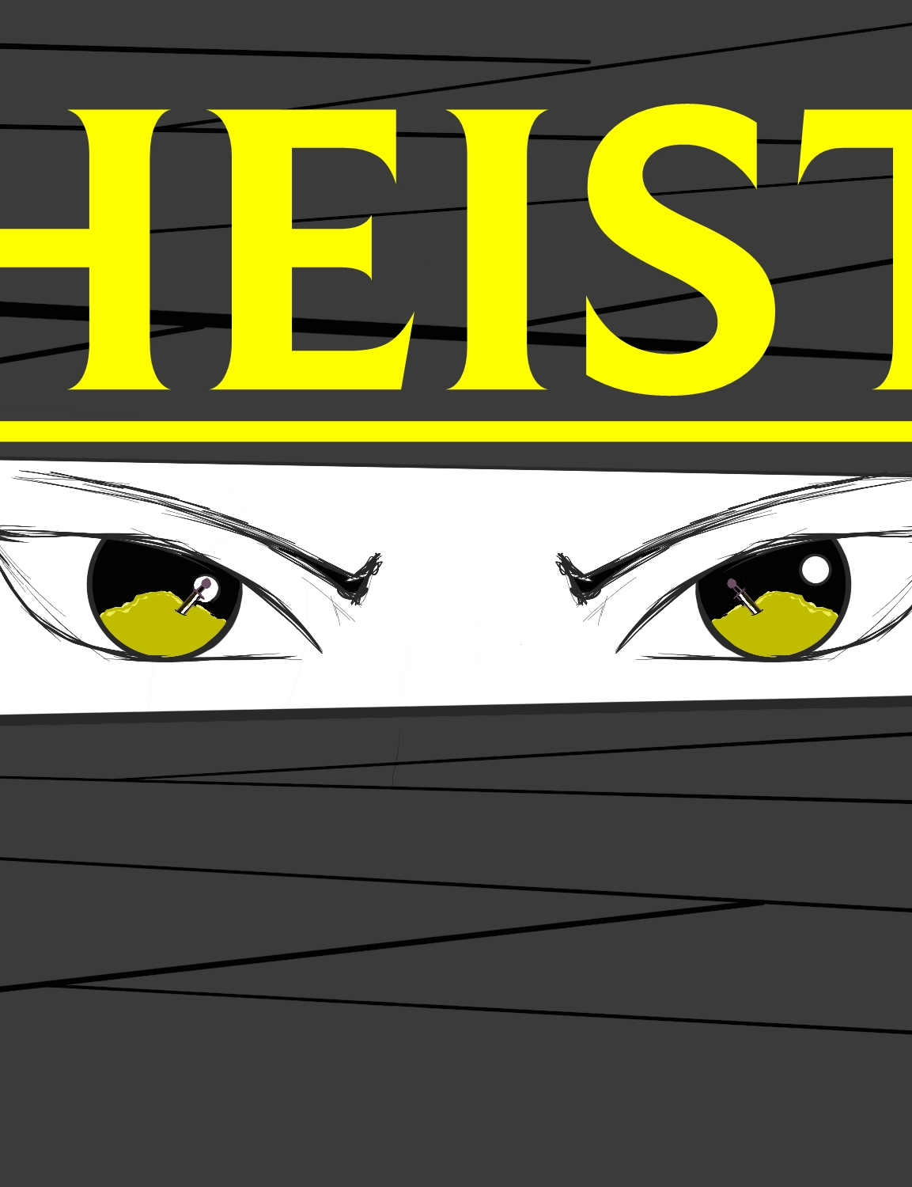
Bold Goats
A futuristic stealth game about a ninja overcoming enemies and obstacles to retrieve key cards to unlock the Sword of Ancients

Slide 2
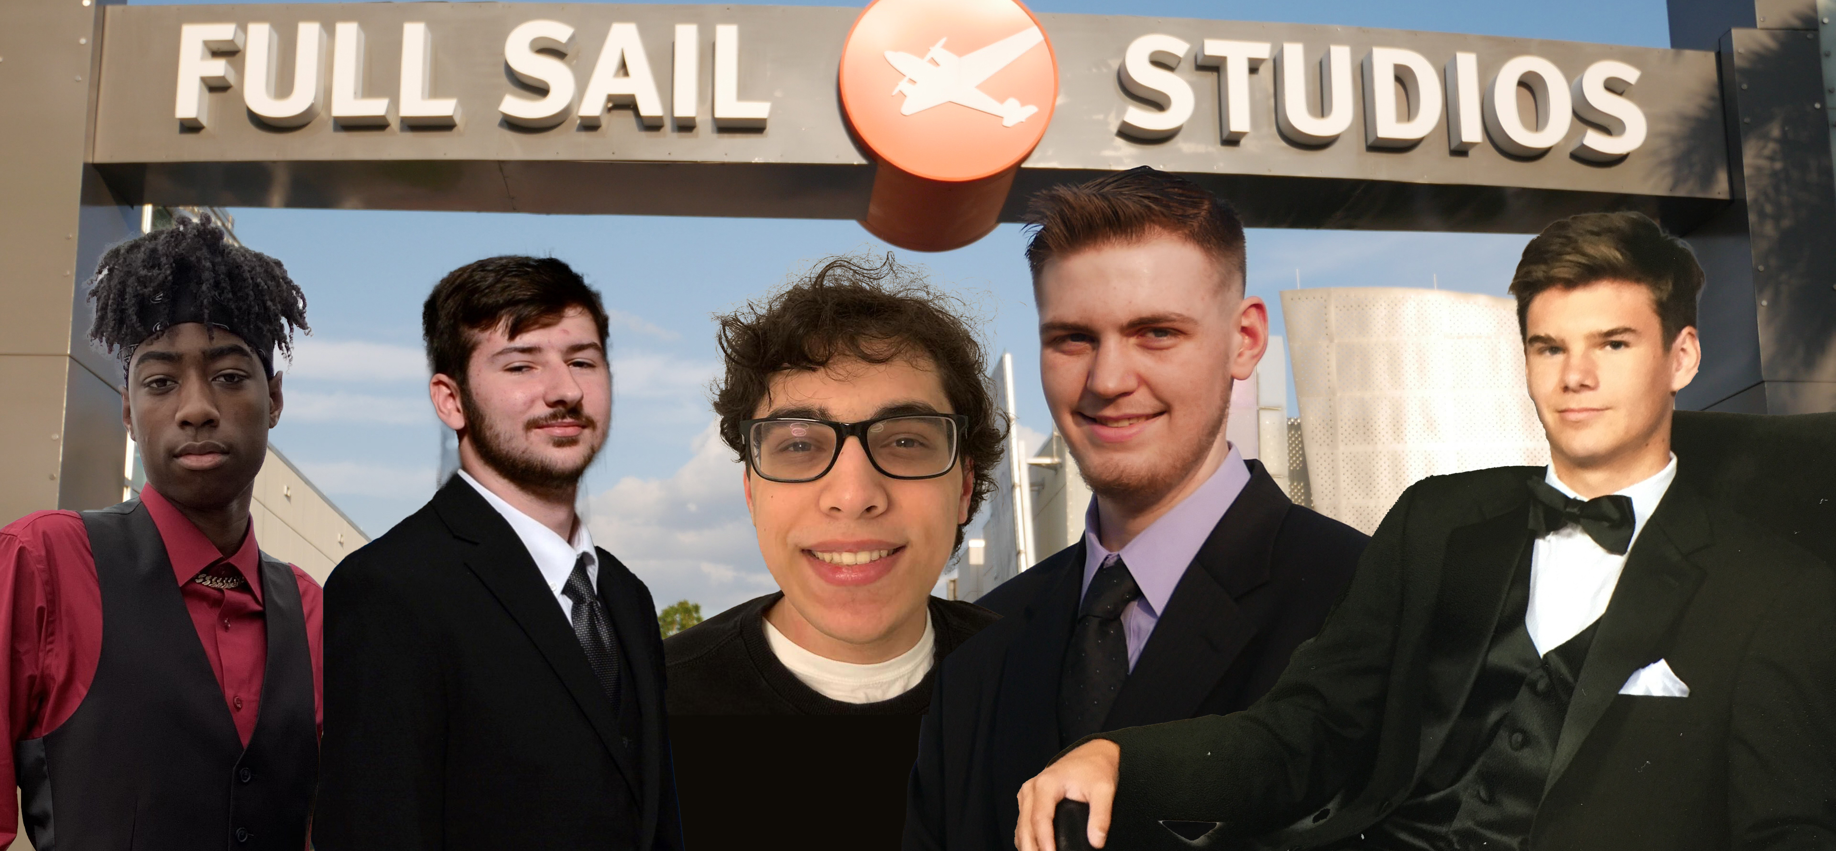
The Team
Owens Nicolas
UI Design & Implementation
HUD
Interaction System
Cameron Stewart
Camera Design and Implementation
Character Animation
Cutscenes
Alexander Morales
Level Design
Asset Modeling
Colliders/Materials
Adam Stagg
Xray Vision
Enemy AI
Sound System
Vision Cone Dynamic Mesh
Game Integration
Project management
Payton Green
Player Controller
Models
Original Concept

Slide 3
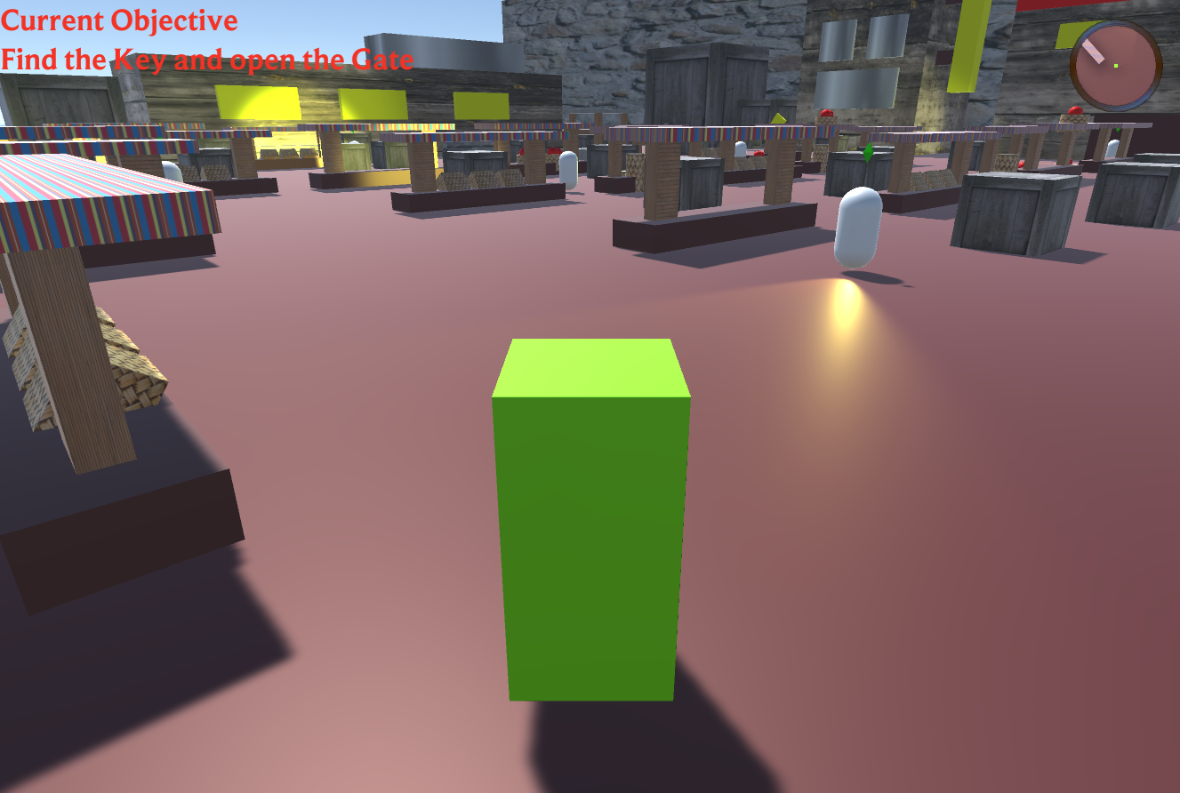
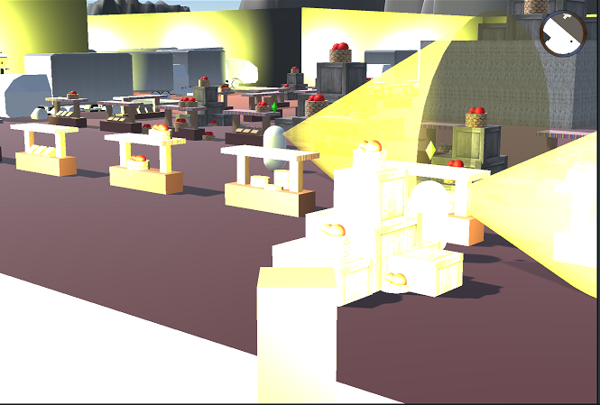
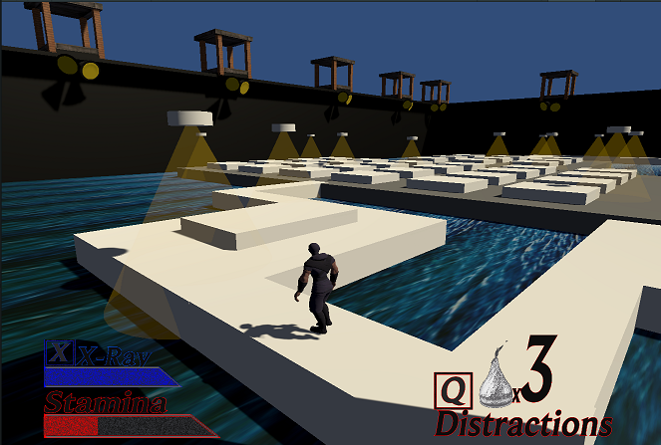
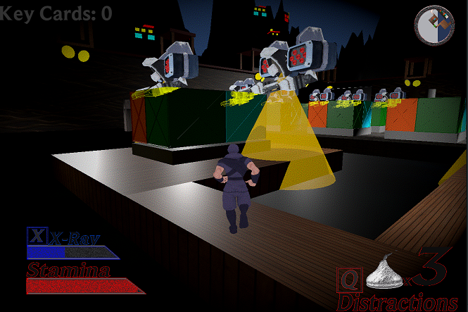
Progress
Prototype
Alpha
First Playable
Final
Notes:
Prototype = PP2 first milestone
First Playable = PP2 final milestone
Alpha = PP3 alpha milestone
Final = Game today

Slide 4
Tips/Tricks
Research, Research, Reasearch
Before implementing foreign packages that'll improve the visual appeal of your game, research what you're implementing first to see if it fits your project and its limitations
Don't be afraid to ask for help
Establish and Organize your tasks
Never stop testing
Take an hour out of your schedule to playtest your game every day. Some problems can't be seen the first time around.
Other people are your greatest helpers. If you don't know how to do something or a concept is too confusing, don't be afraid to ask. "Being the dumbest person in the room means you have the most room to grow"
Being able to establish and organize your group's tasks is an extremely important part to game development. If one cog in the machine is rusted, the entire machine won't work

Slide 5
What Went Right
No problems debugging
Enemies
Enemy design, concept, and implementation worked in unison with the genre and overall goal of the game.
Interaction System
The flexible and versatile interaction system allowed the player to interact with the world and complete the objectives
Implementation of Cutscenes
The new concept of cutscenes being implemented into the game turned out to be a straightforward task with a satisfying end product.
Near the end of our project, we rather fixed most of our bugs quickly and efficiently. No bugs means working game, working game means we have something to turn in.

Slide 6
What Went Wrong
Scenes being deleted
Scripts and Prefabs going missing
When people add or modify scripts or prefabs at the same time problems start to occur. Prefabs and scripts get corrupted and end up having to be remade. To fix it, we remade the scripts and prefabs the were corrupted and communicated as to be sure to not push at the same time as another team member
HDRP turns everything in the scene purple
GIT overwriting work
Having two people work on the same script, but different problems, created more problems in of itself. Scripts or prefabs would be overwritten and the person who pushed last would have the person before them lose all their work. To fix it we had to communicate so only one person was working on one problem at a time.
With people working on the same scene at the same time to get their assigned tasks done in time caused problems in git. People accidentally overlooked seemingly unproblematic changes and pushed them into the repo and caused scenes to disappear. We fixed it by going back into the log and changing the master to the last working commit.
We tried to add the HDRP to improve the lighting and the XRay vision, but it ended up corrupting all of the materials in our game. The only way to fix it was to get rid of it.

